Slide 1

SMART ENERGY METER
Shri Guru Gobind Singhji Institute of Engineering & Technology, Vishnupuri , Nanded, Maharashtra, India, 431606.
Department of Electronics and Telecommunication Engineering
Presented by :
Narayan Navande [2022BEC055]
Om Sonwal [2022BEC067]
Navinya Deshpande[2022BEC077]
Under the guidance of
Mr. Nitin N. Naganpalle
Department of Electronics and Telecommunication Engineering

Slide 2
INTRODUCTION
In today’s world of increasing energy demands and smart automation, monitoring electricity usage in real-time has become essential. This project presents a Smart Energy Meter that provides measurement of voltage and current using the ZMPT101B voltage sensor and ACS712 current sensor. The system is built around the ESP32 microcontroller, which processes sensor data and displays readings on a 16×2 LCD as well as a mobile interface using the Blynk app

Slide 3
Objective
The primary goal of a smart energy meter is to:
Provide energy consumption data.
Reduce human intervention in meter reading.
Enable remote monitoring and control of energy usage.
Promote energy conservation.

Slide 4
Components
Hardware Components
Software Components
ESP32 Wi-Fi & Bluetooth Module: Acts as the microcontroller and communication module, enabling wireless data transfer and remote monitoring.
LCD 16×2 Display: Displays real-time data, including voltage, current, and power consumption.
Current Sensor ACS712: Measures the current flowing through the circuit with high accuracy.
Voltage Sensor ZMPT101B: Detects and measures the voltage of the connected load.
Load: Represents the appliance or device consuming power in the system.
Wires: For electrical connections between components, ensuring seamless operation.
Programming Platform: Arduino IDE = To write and upload code to the ESP32 microcontroller.
IoT Platform: Blynk =To visualize and monitor real-time data like voltage, current, and power consumption remotely

Slide 5
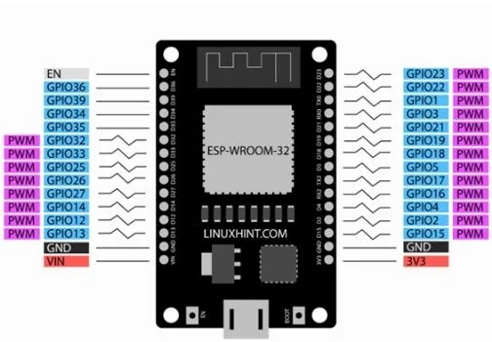
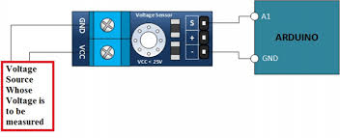
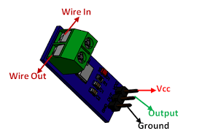
ESP32 Microcontroller
Features:
  Dual-core 32-bit CPU
  Wi-Fi + Bluetooth support (ideal for IoT applications)
  Multiple GPIOs, ADC (Analog to Digital Converter), PWM, I2C, SPI, UART
Role in Smart Energy Meter:
  Collects voltage and current sensor readings via analog input (ADC)
  Processes data to calculate power and energy
  Sends real-time data to Blynk app or web server over Wi-Fi
Voltage Sensor - ZMPT101B
Purpose: Measures AC voltage (typically 230V) safely and outputs a corresponding analog signal
Current Sensor - ACS712
Purpose: Measures current (AC or DC) flowing through a wire

Slide 6
Block diagram
Current Sensor ACS712
LCD 16×2 Display
ESP32 Wi-Fi & Bluetooth Module
LOAD
IoT Platform: Blynk
Voltage Sensor ZMPT101B

Slide 7
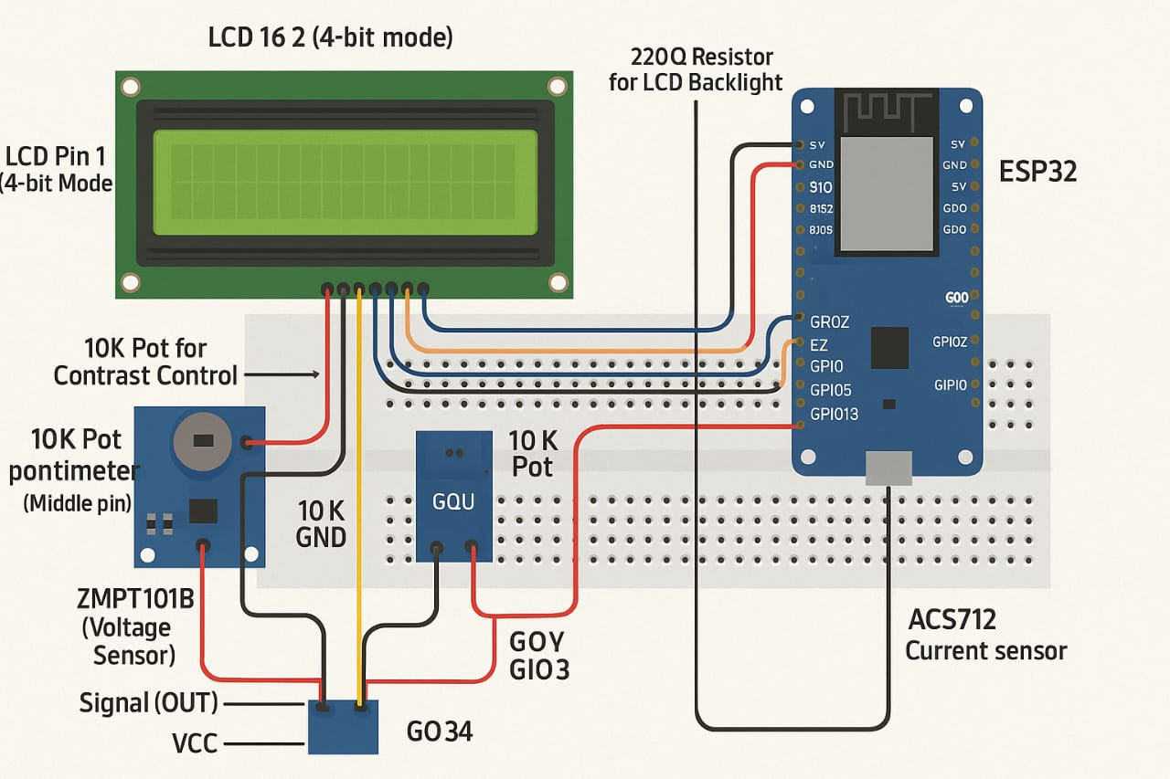
Circuit Diagram
Users can view all parameters and updates remotely.

Slide 8
Working Principle
1. AC Supply to Load
An AC power source (230V, 50Hz) is applied to an electrical load (e.g., a fan, bulb, etc.).
2. Sensor Measurements
Voltage Sensor (ZMPT101B):
  Measures voltage across the load , Output: Analog voltage to ESP32 , Unit: Volts (V)
Current Sensor (ACS712):
  Measures current flowing through the load, Output: Analog current signal to ESP32 Unit: Amperes (A)
 | Calculation Type | Formula | Description
1 | Power Calculation | Power (W) = Voltage (V) × Current (A) | Calculates instantaneous power consumption.
2 | Energy Consumption | Energy (kWh) = Power (W) × Time (h) | Total energy calculated over time.
3 | Cost Estimation | Cost = Energy (kWh) × Rate (per kWh) | Estimates electricity costs based on consumption.
4 | Real-time Display | Displays on LCD and Blynk app | Allows users to monitor costs effectively.

Slide 9
Future Scope
Integration with IoT dashboards, remote control via apps like Blynk, and mobile alerts for abnormal energy usage.
Monitoring of grid and renewable sources with automated daily, weekly, and monthly energy reports.
AI-based energy prediction, dynamic tariff calculation, and automated overload protection features.
Voice assistant support (Alexa/Google Home) and cloud-based multi-user access for easy management.

Slide 10
Traditional vs Smart Energy Meter
Feature | Traditional Energy Meter | Smart Energy Meter
Reading Method | Manual (requires personnel) | Automatic (real-time digital reading)
Data Monitoring | No live monitoring | Real-time monitoring via mobile/web
Energy Usage Insights | Not provided | Detailed usage analytics available
Maintenance Cost | Higher due to manual intervention | Lower due to remote diagnostics
Connectivity | No connectivity | IoT-enabled (Wi-Fi, Bluetooth, etc.)

Slide 11
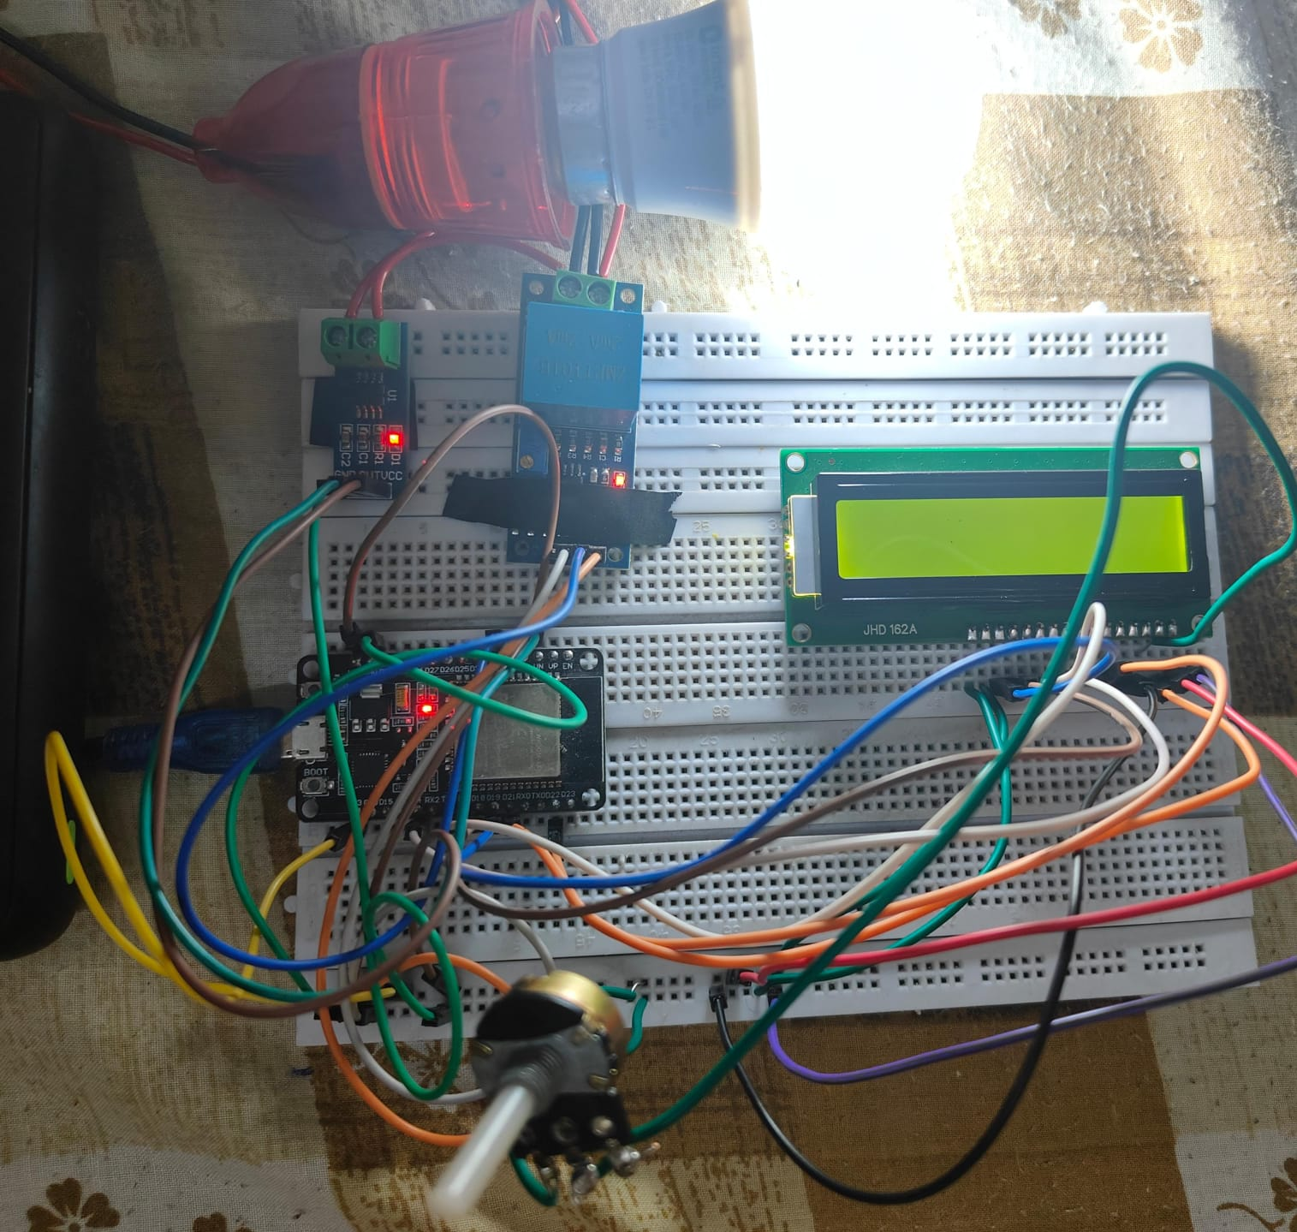
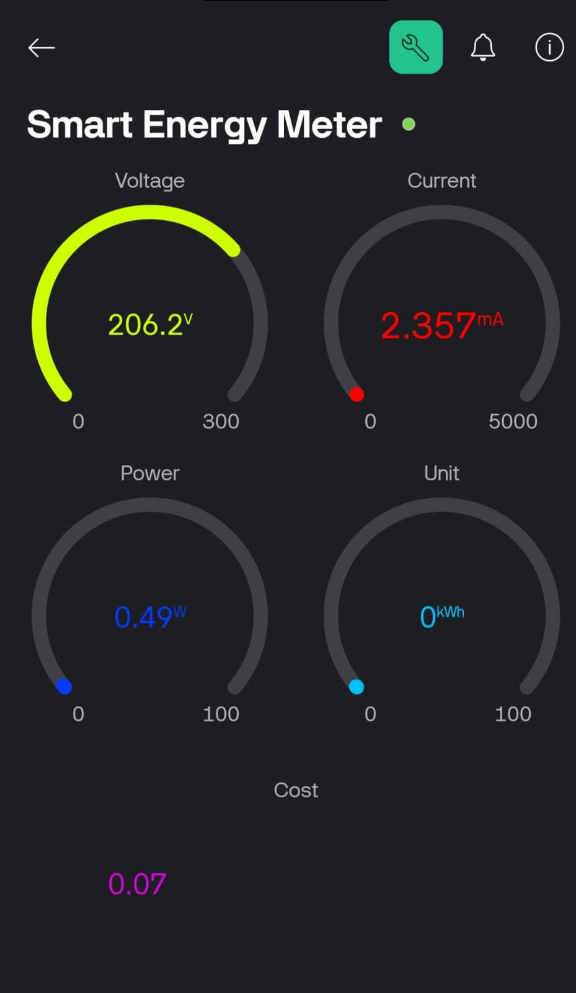
Output

Slide 12
conclusion
The smart energy meter improves energy accuracy and accessibility.
It supports sustainability by enabling efficient resource use and conservation.
This project highlights integration of IoT with power monitoring technology.

Slide 13
Thank you

